Slide 1
Contract Monthly Claim System (CMCS)
Part 3 – System Demonstration Presentation
Student: Annele Ndlovu

Slide 2
System Overview
• Web-based monthly claim submission system
• Users: Lecturers, Coordinators, Managers
• Features: Claim submission, approvals, status tracking

Slide 3
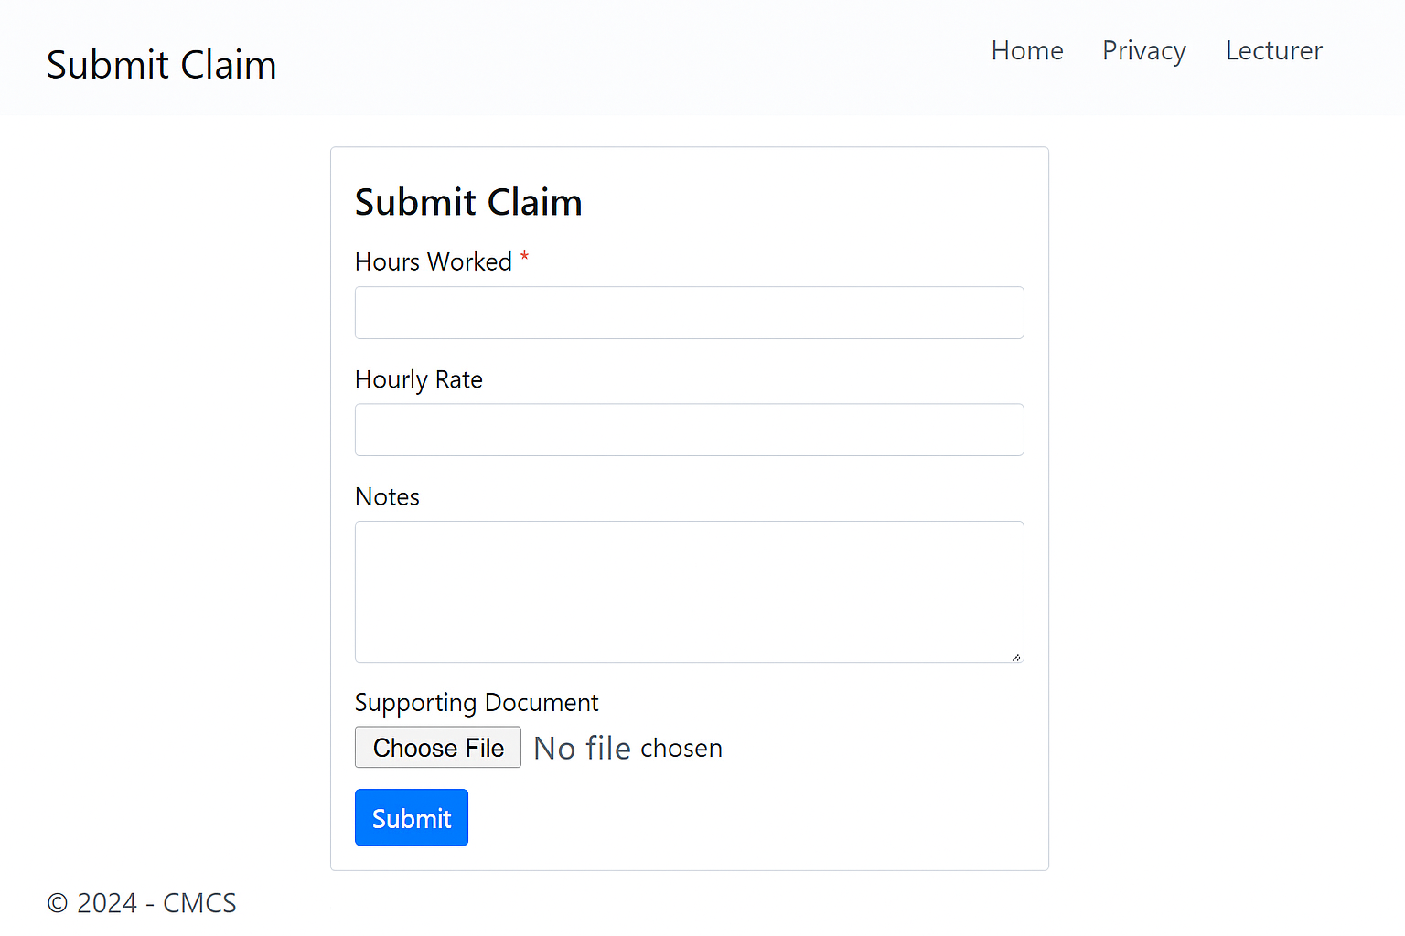
Lecturer Submitting a Claim

Slide 4
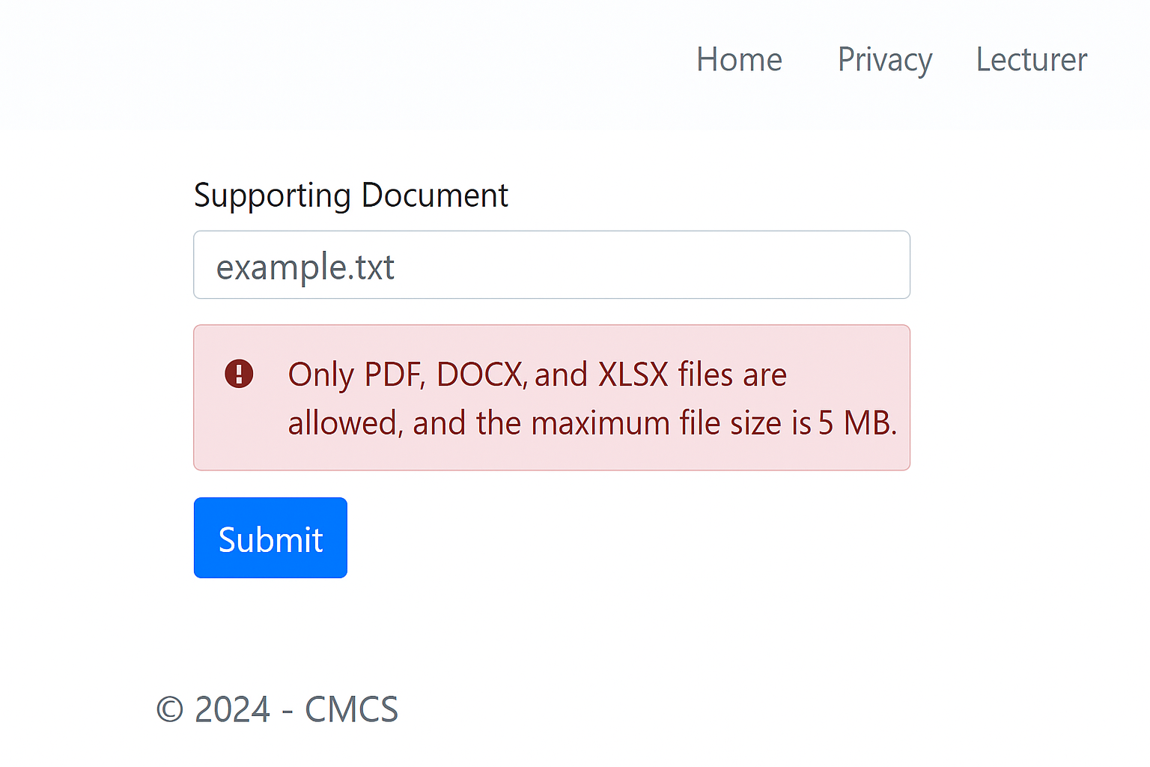
File Upload Validation Message

Slide 5
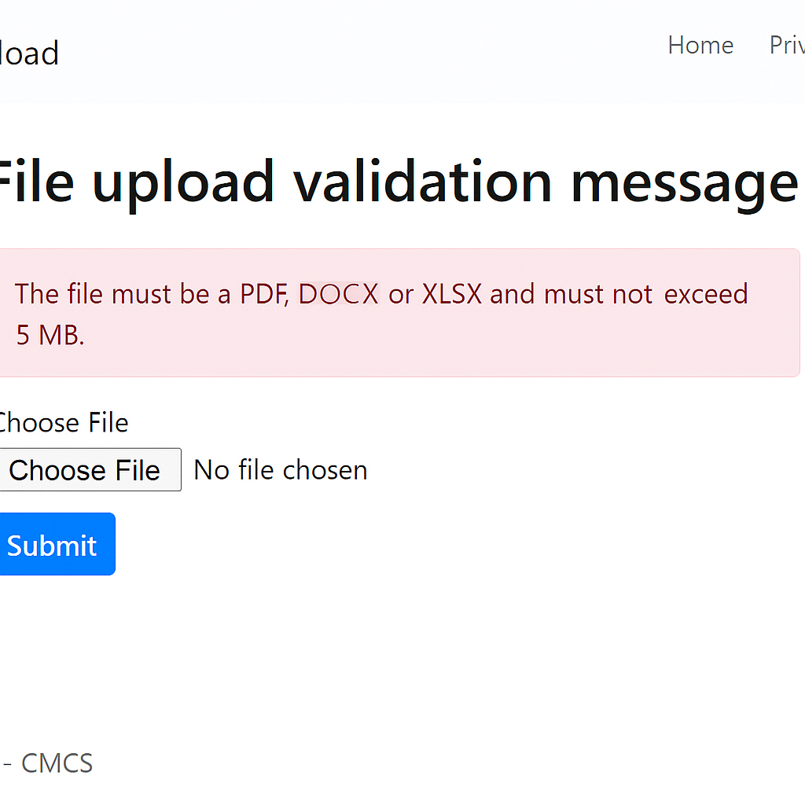
Coordinator Approval Page

Slide 6
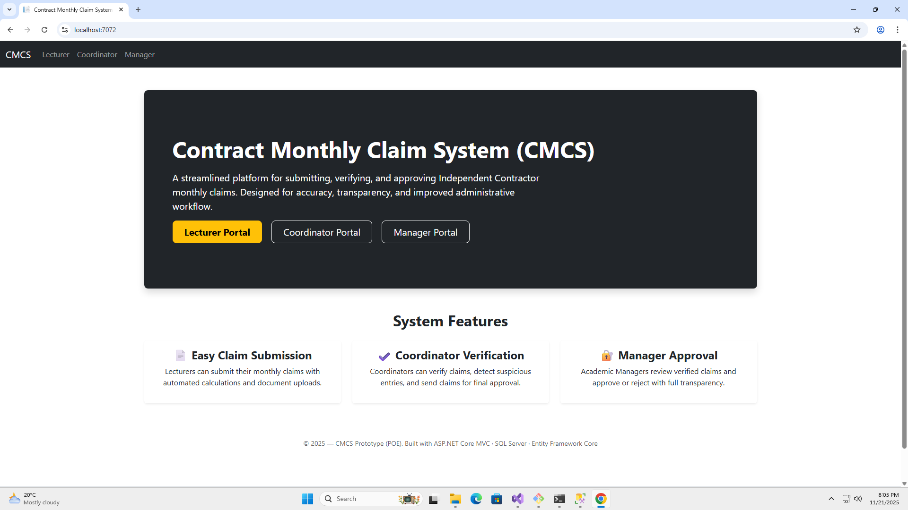

Slide 7
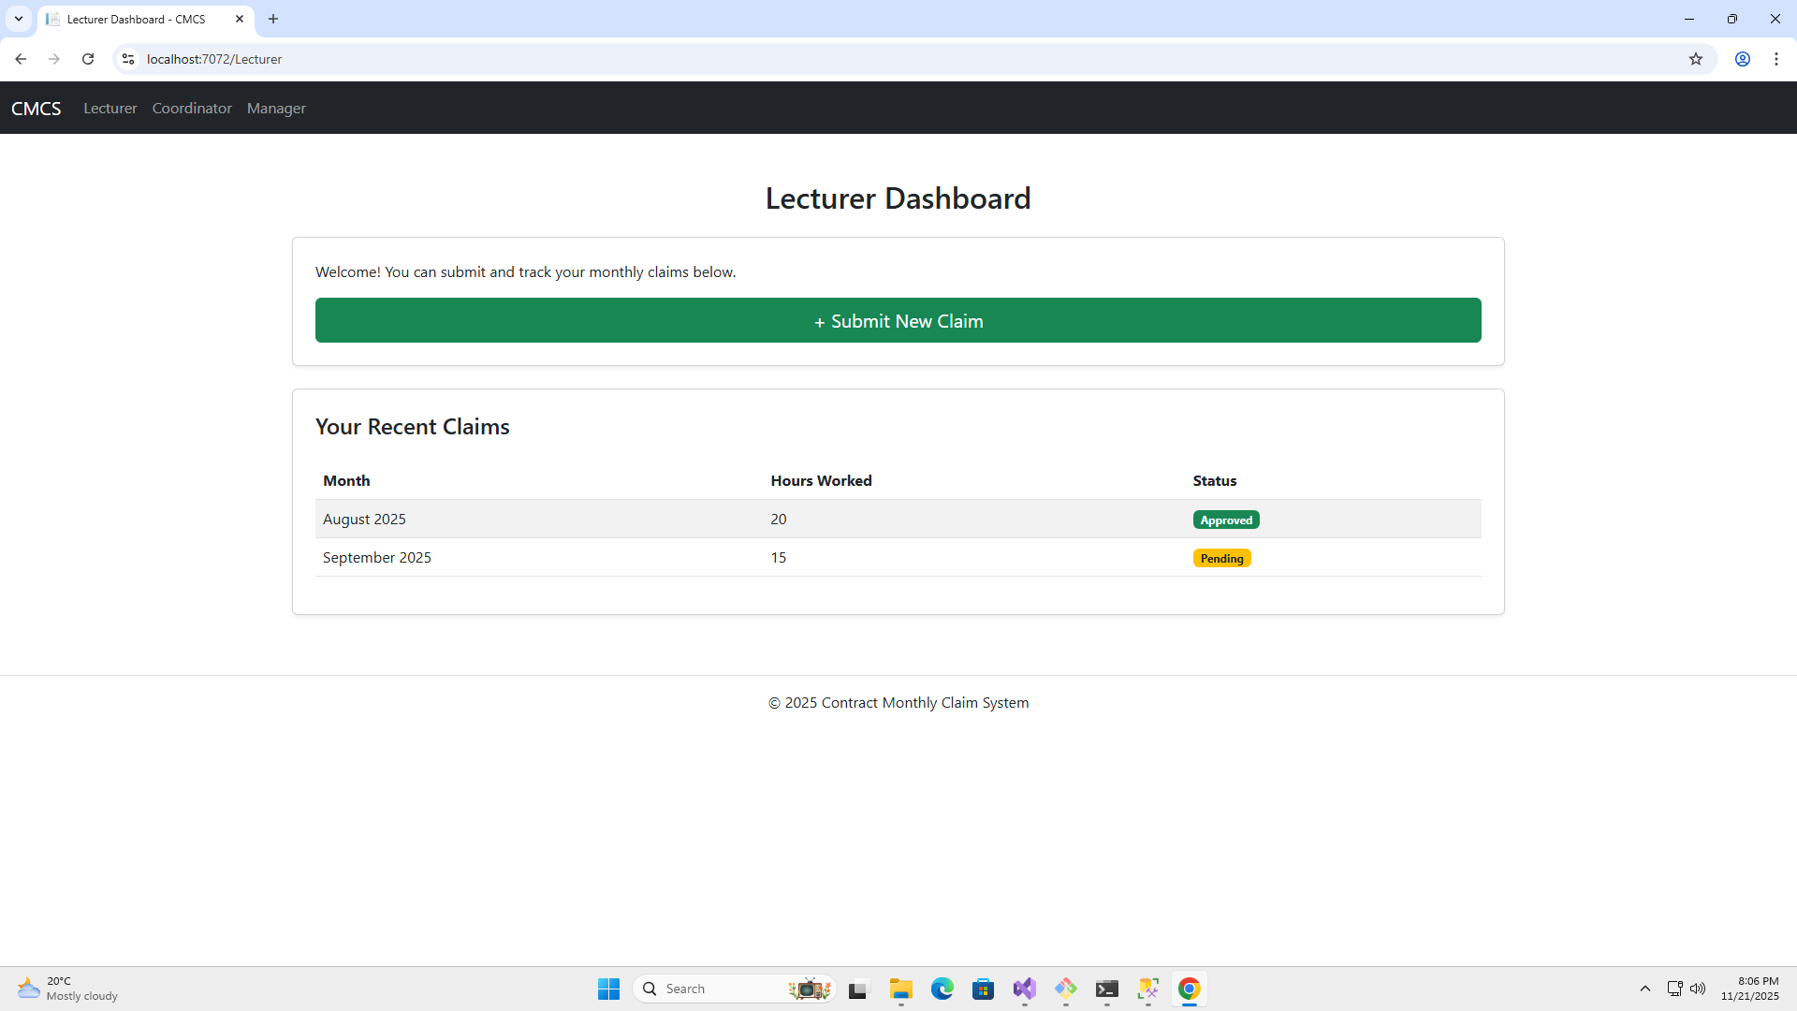

Slide 8
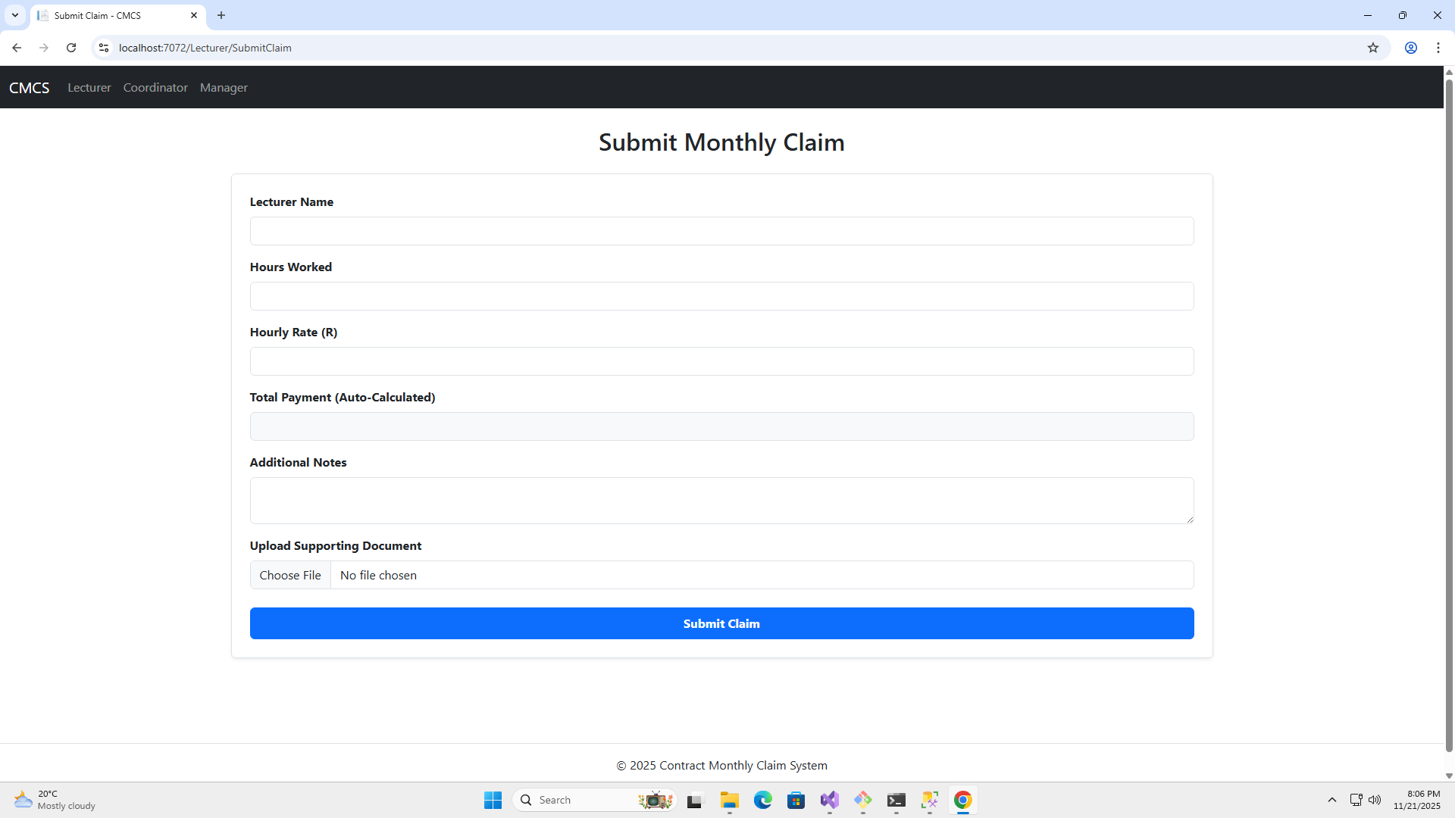

Slide 9
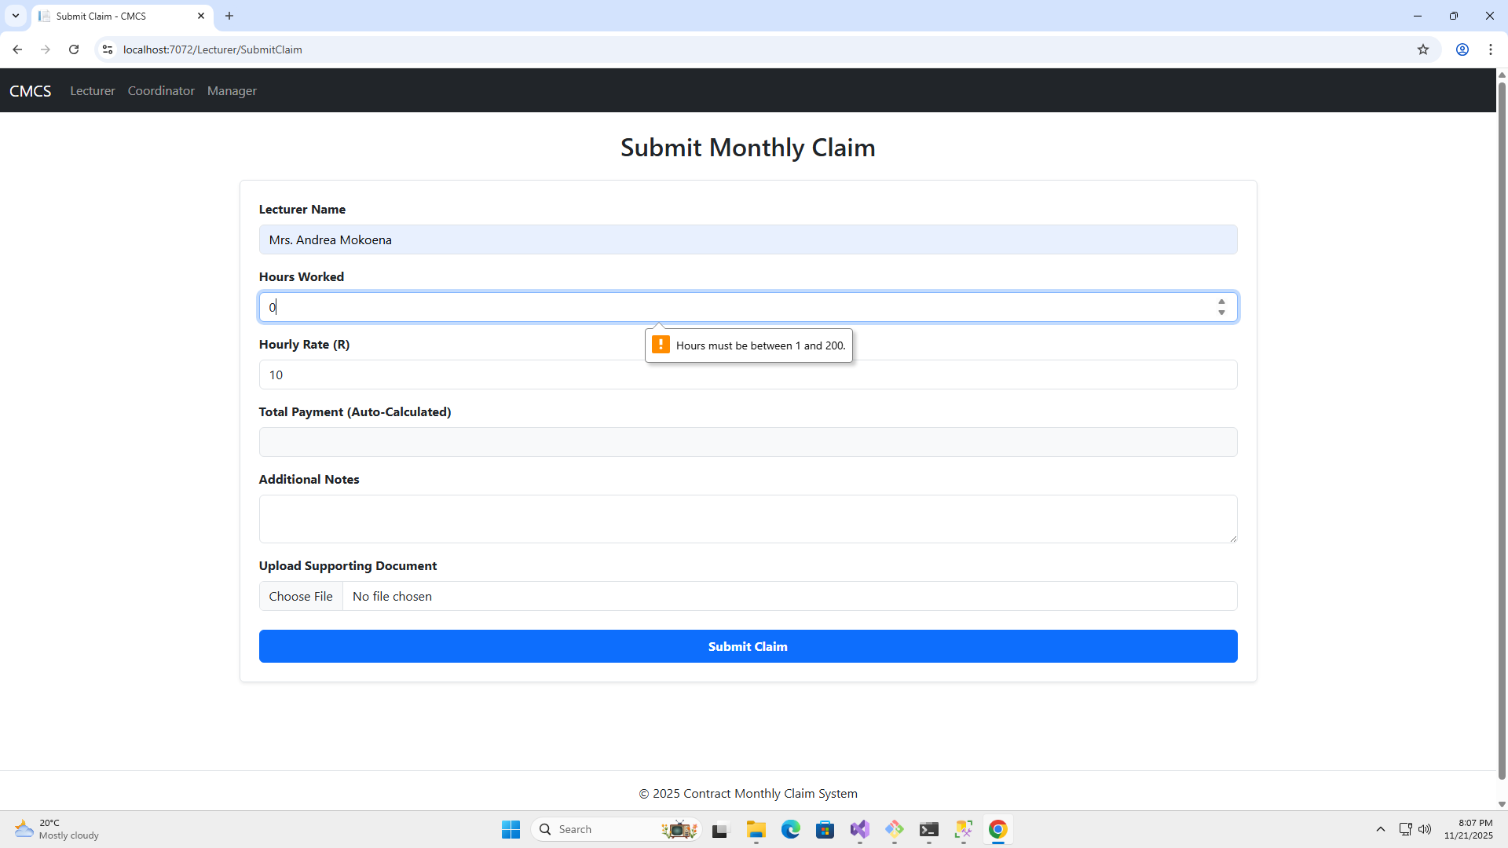

Slide 10
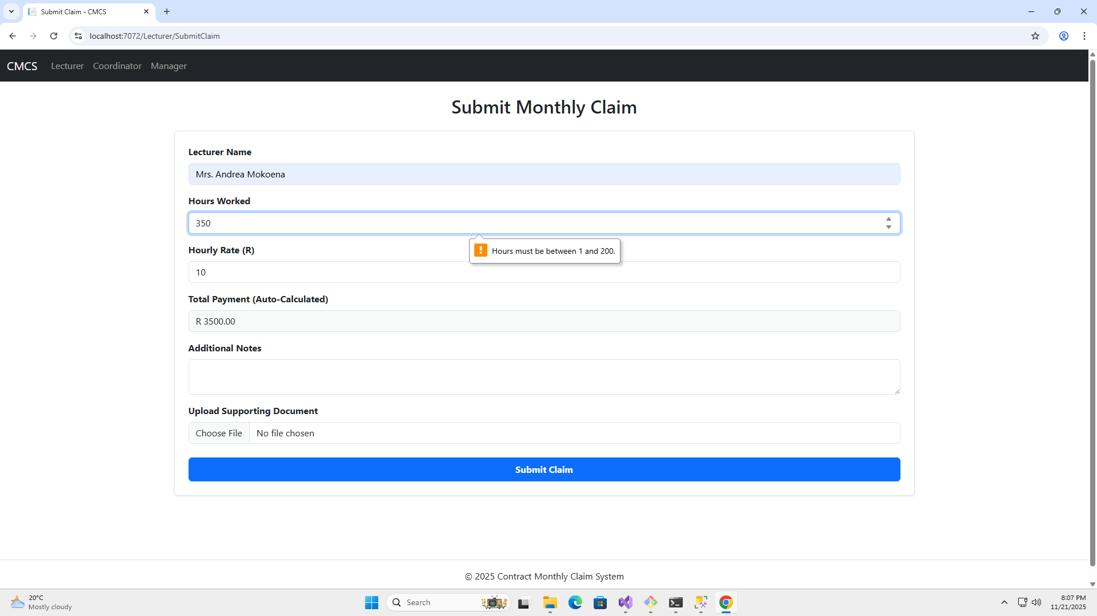

Slide 11
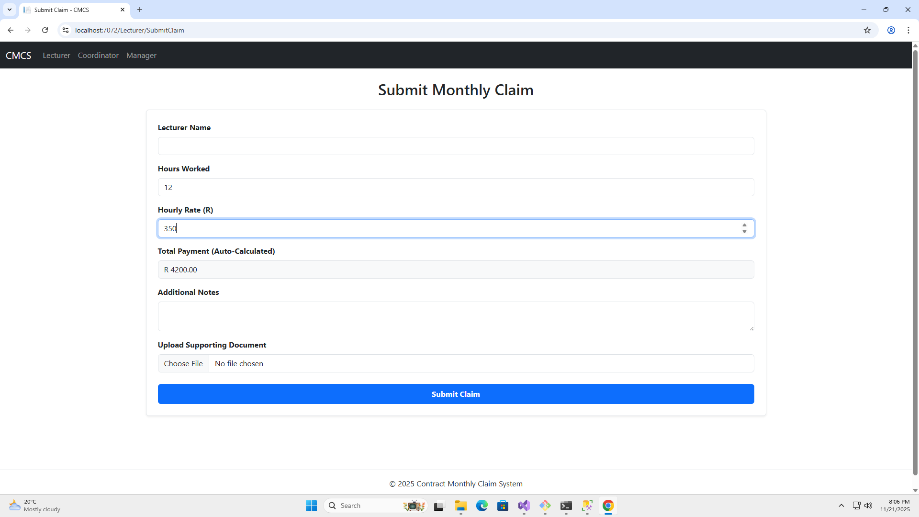

Slide 12
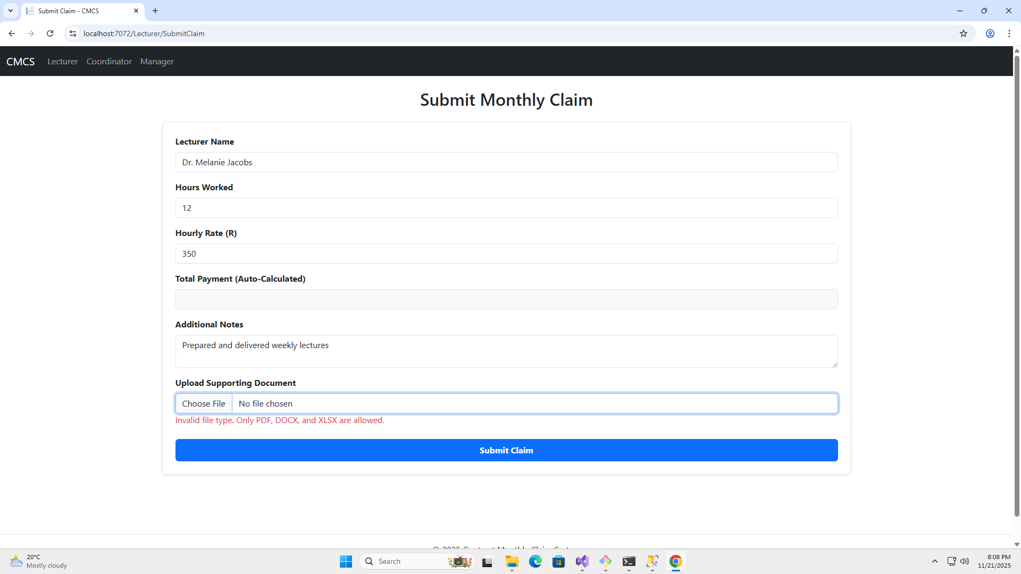

Slide 13
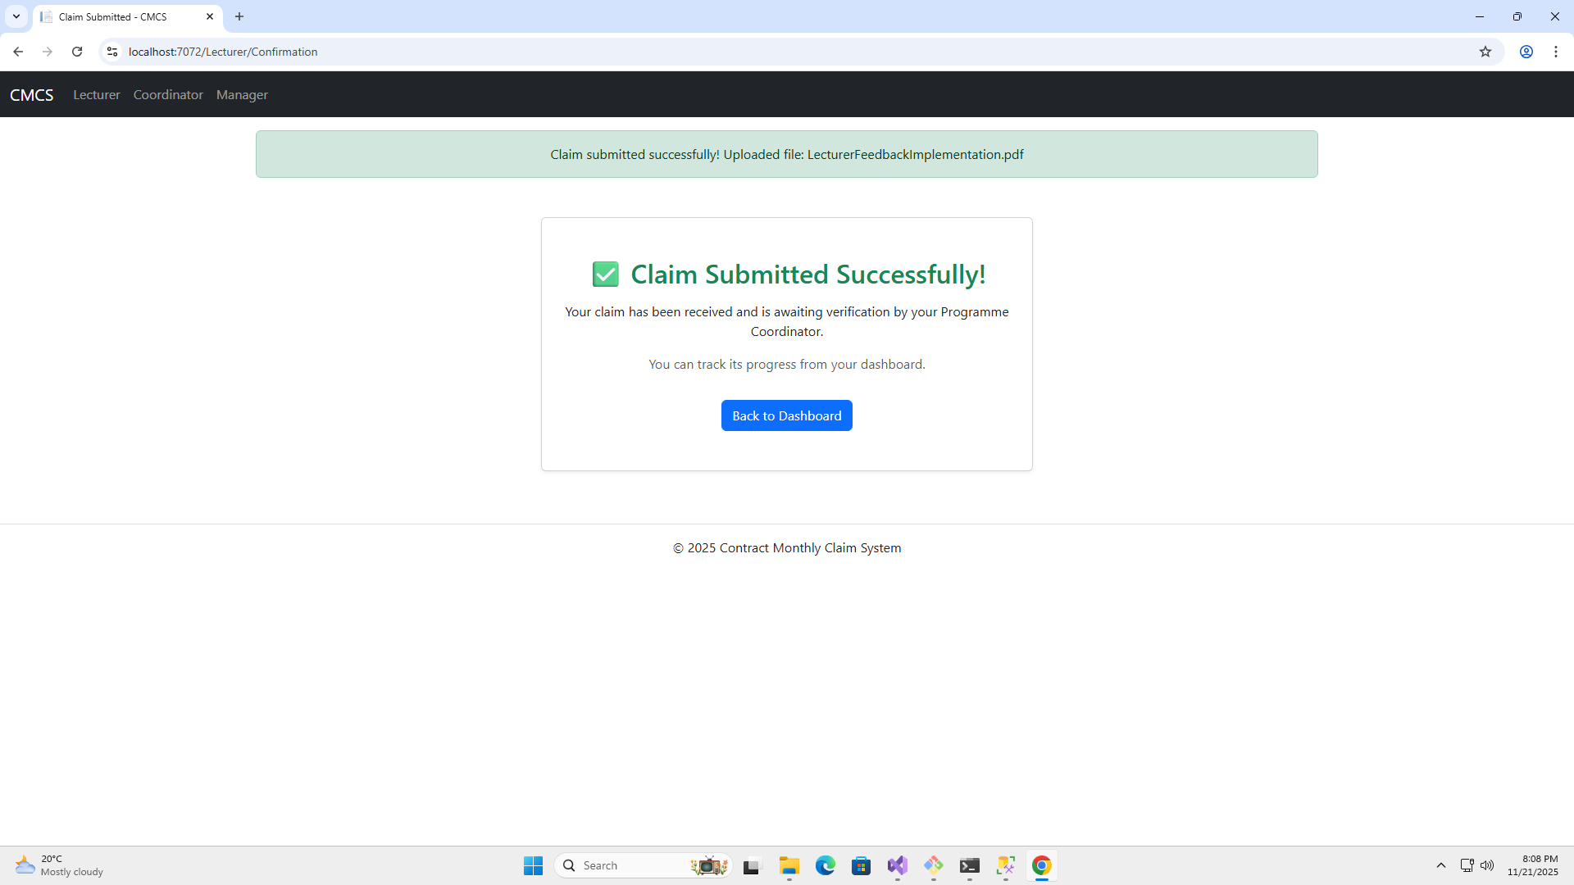

Slide 14
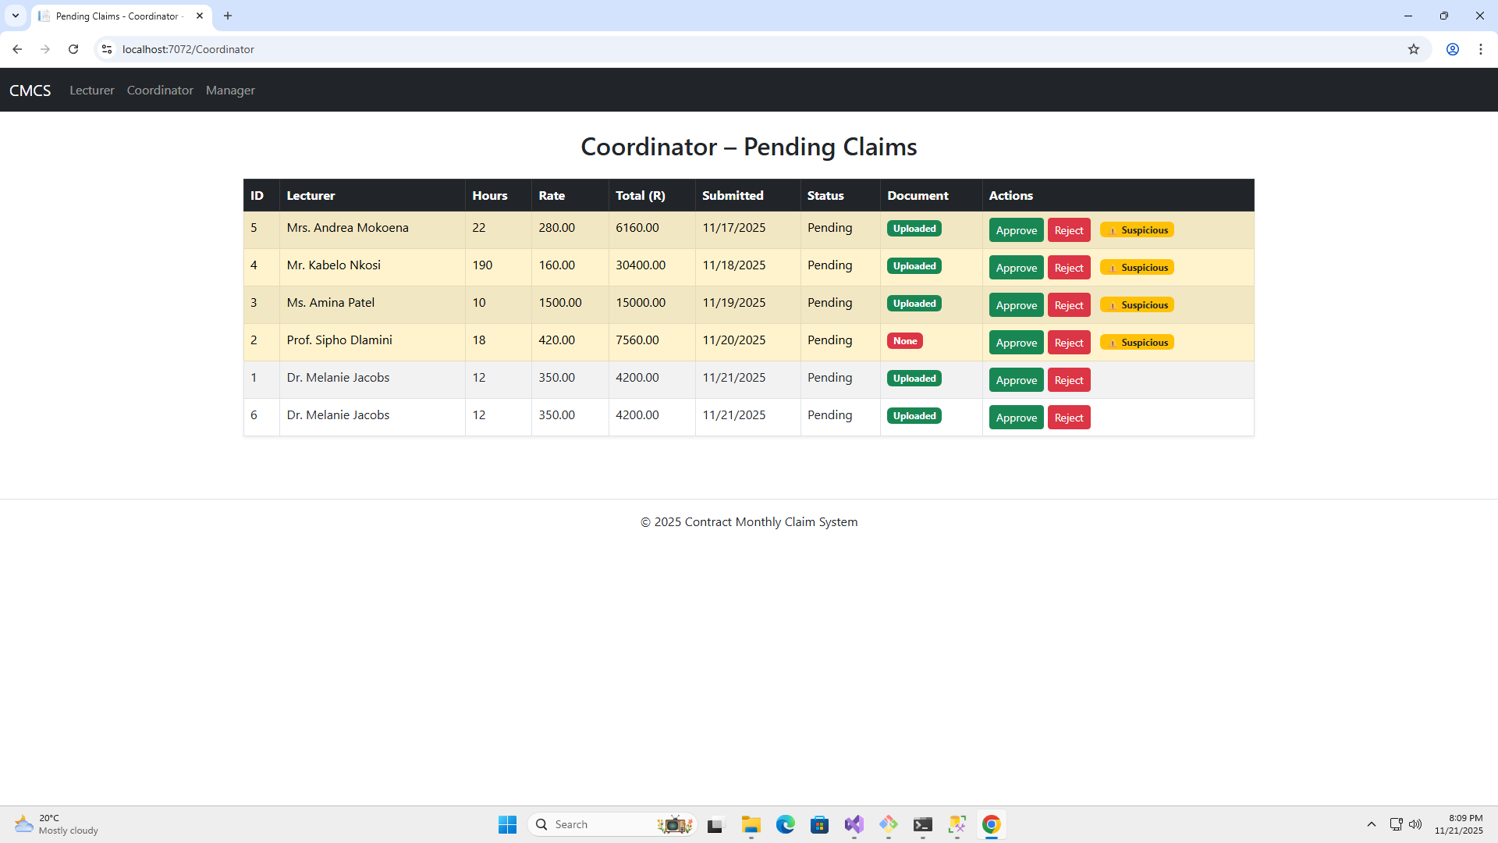

Slide 15
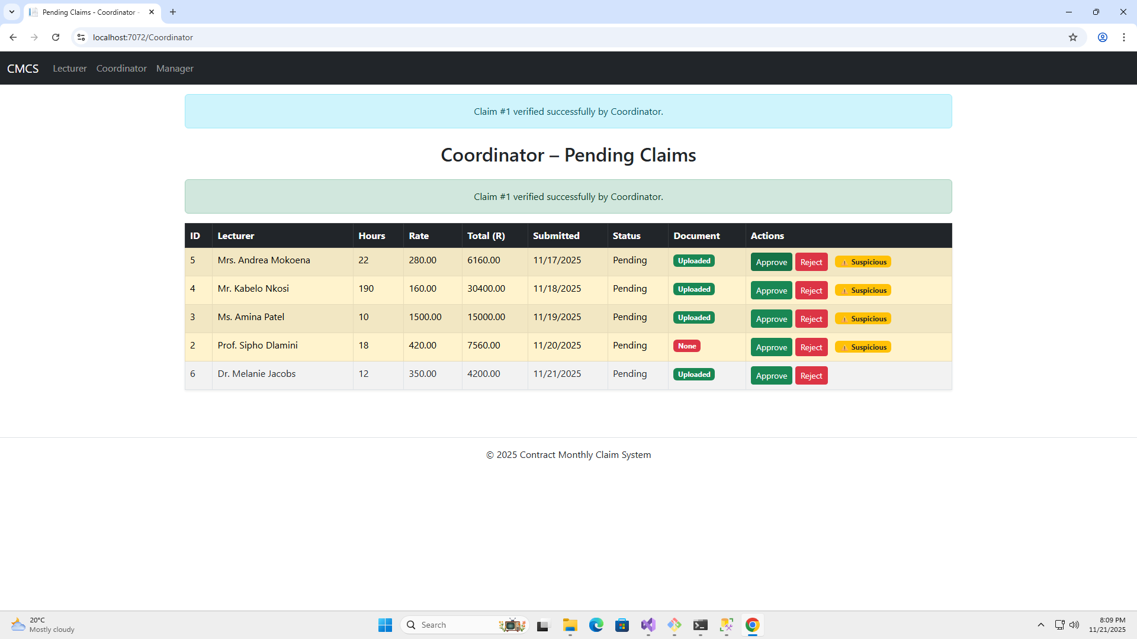

Slide 16
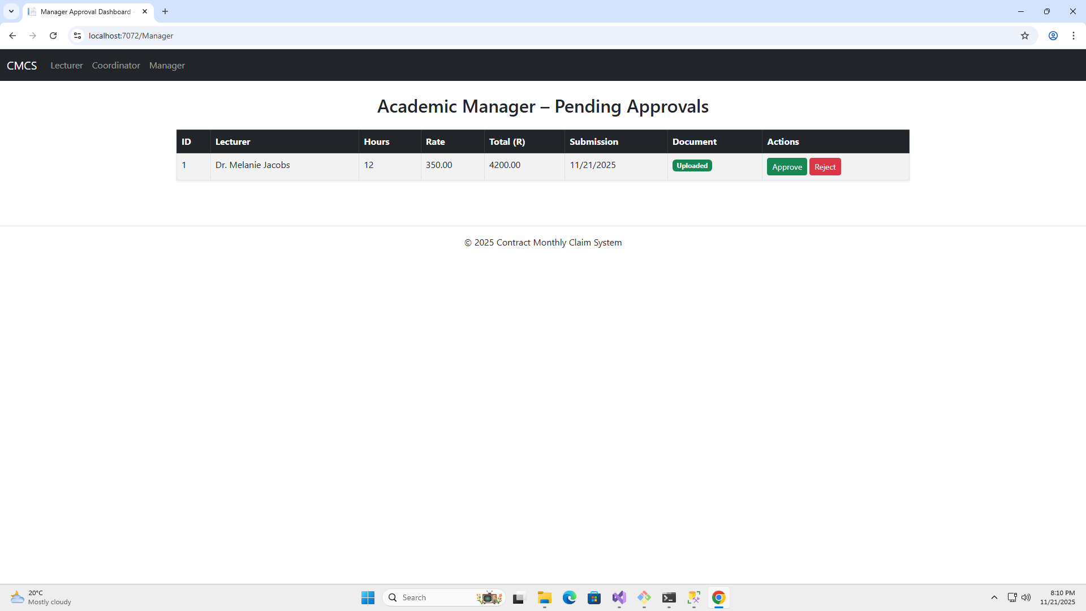

Slide 17
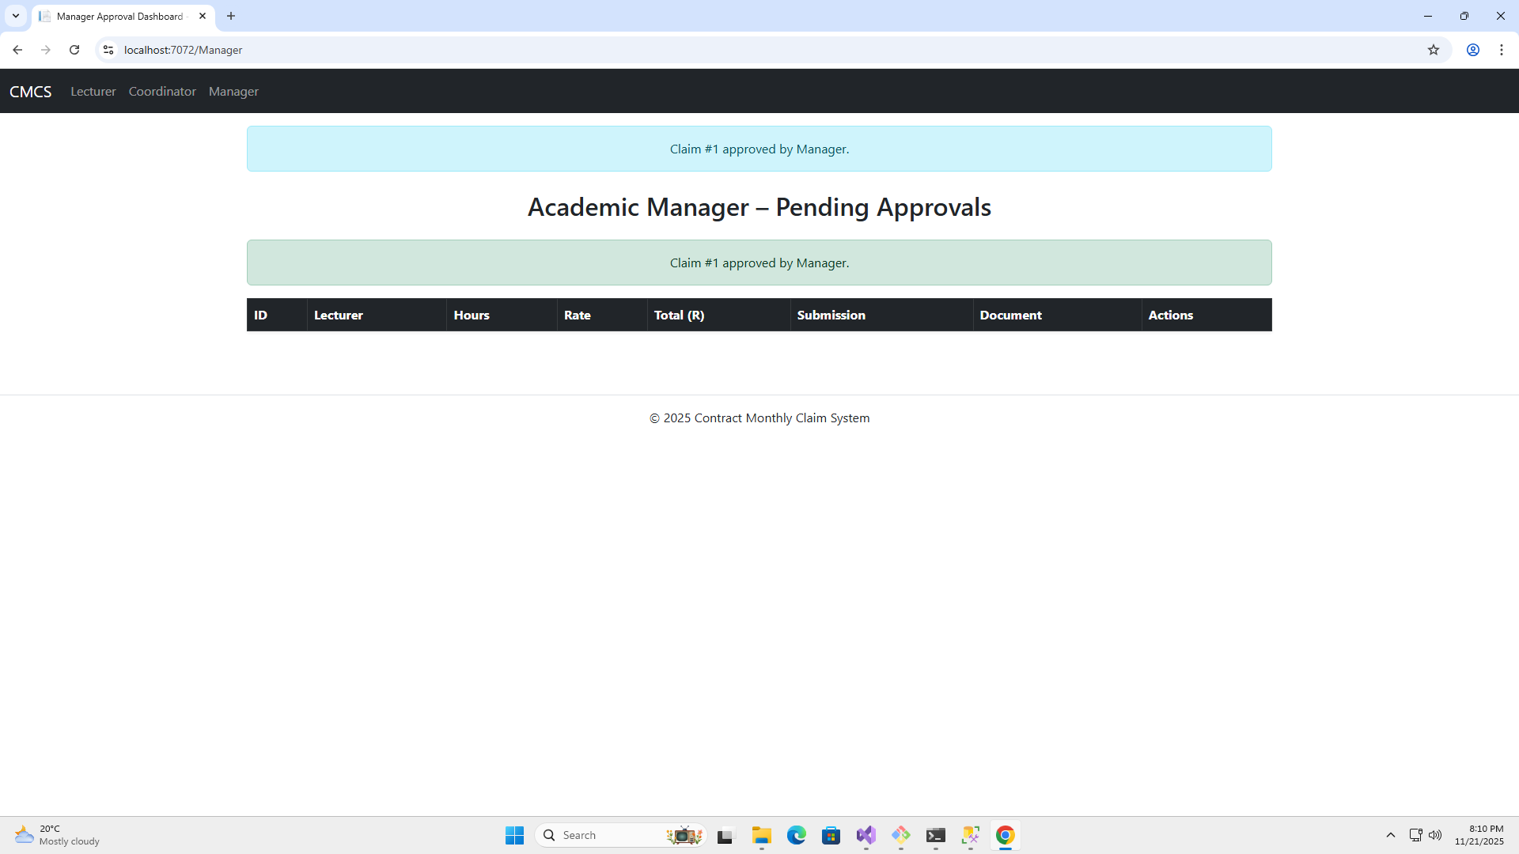

Slide 18


Slide 19
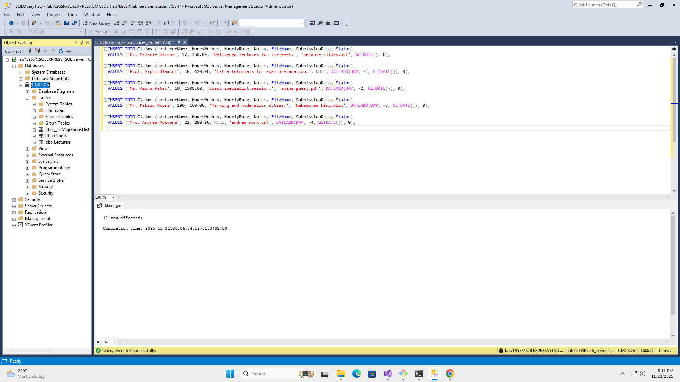

Slide 20
